Slide 1
RACI
Utilizing Software to Create
and Maintain a RACI Matrix
Project Management through Responsibility Assignment
Presenters: Jose Daniel Moya Moreno, Álvaro Puebla Ruisánchez | Date: 14/04/2026
Notes:
Hi everyone! My name is Jose Daniel, and with my colleague Álvaro, we'll be talking about 'Utilizing software to create and maintain a RACI matrix, a technique applied in real projects to assign responsibilities.
Standalone application
https://www.visual-paradigm.com/support/documents/vpuserguide/285/2138/56971_formingracic.html
Important connection with EPC and BPM
Online template (xlxs)
https://online.visual-paradigm.com/app/office/#proj=0&type=Spreadsheet&import=The-RACI-Matrix.xlsx

Slide 2

Why Projects Fail Without a RACI Matrix
Problems:
Multiple people involved
Unclear Role Assignments
Duplicate Work
Nobody knows who is actually responsible for what. Some tasks have no owner at all. Nobody picks them up because everyone assumes someone else is handling it.
Two or more people unknowingly perform the same task, wasting time and resources.
Accountability Confusion
Hidden Decision Paths
When something goes wrong (which eventually will happen), there's no single person who owns it. Blame starts shifting around the team.
The work is done, it's ready to be approved, but nobody knows whose sign-off is actually needed. So, it just waits.
2
Notes:
So, before we get into the definition, let me give you a bit of context. In any project, there are always multiple people involved, but not everyone plays the same role.
Some people are doing the actual work, some are approving it, some are just giving feedback...
The more complex a project gets: more tasks, more people, more dependencies, the more critical it becomes that everyone knows exactly what to do, because if that's not clear, things will go wrong.
Here are some problems that projects could run into:
1) The first problem is unclear role assignments. Nobody knows who is actually responsible for what. Some tasks have no owner at all. Nobody picks them up because everyone assumes someone else is handling it.
2) Another problem is duplicate work. The opposite problem — two people are both doing the same task without knowing it. You end up with two versions and wasted time
3) Third, accountability confusion. When something goes wrong (which eventually will happen), there's no single person who owns it. Blame starts shifting around the team.
4) And finally, hidden decision paths. The work is done, it's ready to be approved, but nobody knows whose sign-off is actually needed. So, it just sits there.
Well, all these problems have the same root cause: nobody sat down at the beginning and clearly defined who does what.
And that's exactly where the RACI matrix comes into action.

Slide 3
What is a RACI Matrix?
RACI is an acronym. It stands for Responsible, Accountable, Consulted, and Informed. And it maps every single task in your project to one of these four roles for each stakeholder.
R
A
C
I
Responsible
Accountable
Consulted
Informed
The Doer
Does the actual work for the task
The Decision-Maker
Final approval & ownership
The Advisor
Provides expertise & input
The Recipient
Kept updated on progress
3
Notes:
In a RACI matrix, also called RACI model or RACI diagram, the name is an acronym which stands for Responsible, Accountable, Consulted, and Informed.
It maps every single task in your project to one of these four roles for each stakeholder.
Responsible: is the doer. The person or people actually doing the work. There should always be at least one per task.
Accountable: is the decision-maker. The one who signs off on the work. There should only be one accountable person per task.
Consulted: these are the 'advisors', they don't do the work but provide the 'know-how' to make sure it's done right. Each task can have 0, 1 or more.
Informed: these are the recipients. They just need to know what's happening. You're not asking for their opinion, you're just keeping them updated. Each task can have 0,1 or more
This is a simple concept but incredibly powerful when applied consistently across a whole project.
It is created typically by the project manager at the start of the project, and it must be maintained and updated as the project evolves.
It’s a living document that keeps the team aligned from day one until the finish line.

Slide 4
The Project Manager's Perspective
As Project Managers, our job is not just to track tasks - it's to ensure everyone knows exactly where they stand.
01
Define Clear Accountability
Every task needs one owner. Not a team, not a group, just one person who is ultimately responsible for that task being delivered
02
Prioritize Clarity Over Process
Don't add too many roles, too many columns, too much details. The best RACI matrix is the simplest one
03
Establish a Single Source of Truth
It should not be in someone's email, notes, or verbal agreement, it needs to be one document, one place, that everyone refers to
04
Enable Real-Time Visibility
The team should be able to open the document and find the answer in seconds. Anytime, from anywhere
4
Notes:
RACI matrix is not just a concept, it has to meet different requirements from the project manager's perspective and from the user needs.
As a project manager, your job is not just to track tasks on a list
He must make sure that every single person on the team knows exactly where they stand at every moment of the project. In practice, it comes down to four things:
First, define clear accountability. Every task needs one owner. Not a team, not a group, just one person who is ultimately responsible for that task being delivered
Second, prioritize clarity over process. Don't add too many roles, too many columns, too much details. The best RACI matrix is the simplest one
Third, establish a single source of truth. It should not be in someone's email, notes, or verbal agreement, it needs to be one document, one place, that everyone refers to
And fourth, enable real-time visibility. The team should be able to open the document and find the answer in seconds. Anytime, from anywhere

Slide 5
User Needs: What Must the Software Deliver?
From the Project Manager's perspective, the ideal RACI tool must fulfill these core business requirements:
Visual Clarity
Easy Editing
The matrix needs to be immediately readable, no manual needed.
Projects are living things. As they evolve, we need to add or remove roles and tasks in seconds without the layout breaking.
Centralization
Export Capability
Every responsibility assignment lives in one centralized place. Not in emails, not in papers.
At some point you need to communicate this to stakeholders who are not in the tool. You need to be able to generate a clean PDF or XSLX.
Collaboration
Version Control
This is a team tool, not a personal one. When someone makes a change, everyone sees it immediately.
This collaboration must be backed by version control where you are able to look back and see what changed, when it changed, and who changed it.
5
Notes:
Okay, so we've established why we need a RACI matrix and what a project manager expects from it.
Now the question becomes, what does the software we use to build and maintain it actually need to do?
The first thing is visual clarity. The matrix needs to be immediately readable, no manual needed. Just the tasks and roles as rows and columns
Second: easy editing. Projects are living things. As they evolve, we need to add or remove roles and tasks in seconds without the layout breaking.
Third, centralization. as we said before one document, one place. Every responsibility assignment lives there. Not in emails, not in papers.
Fourth, export capability. At some point you need to communicate this to stakeholders who are not in the tool. You need to be able to generate a clean PDF or XSLX.
Fifth, collaboration. This is a team tool, not a personal one. When someone makes a change, everyone sees it immediately.
This collaboration must be backed by version control where you are able to look back and see what changed, when it changed, and who changed it.
These requirements are what we used to evaluate the tools we're going to show you next.

Slide 6
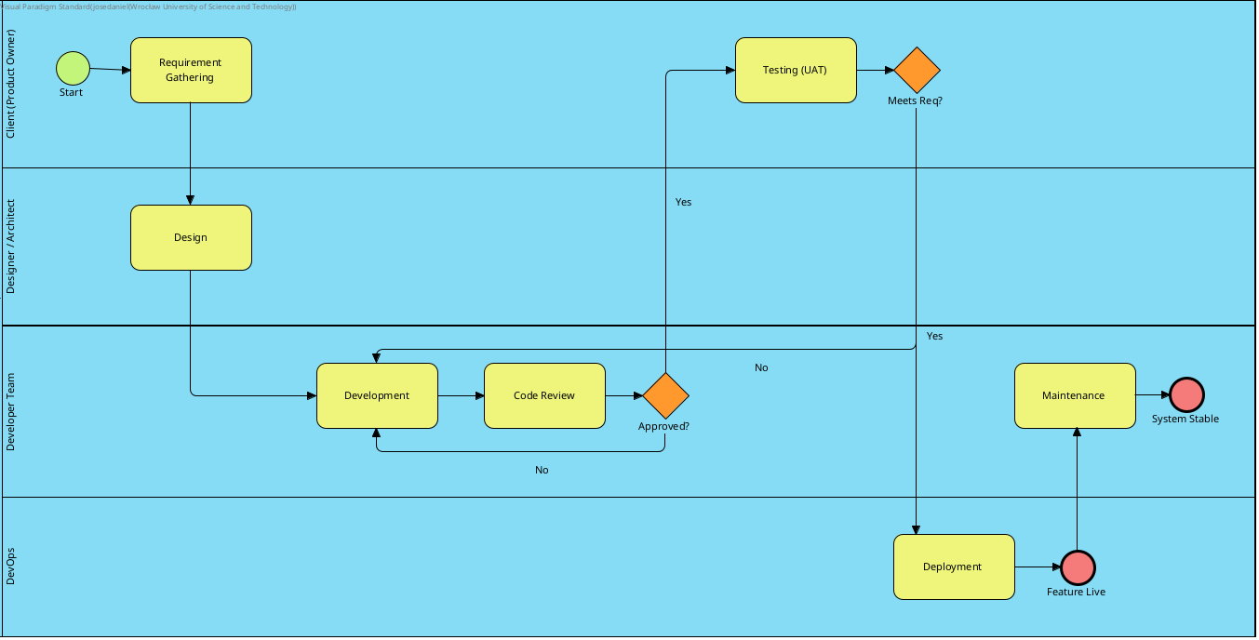
Business Process Model and Notation (Visual Paradigm)
6
Notes:
Before exploring the different tools we can use for this task, I want to show that in real projects RACI matrix is not an independent tool but it usually is created from the BPMN Process Diagram or EPC Diagram.
Using Visual Paradigm as an example, here is a BPMN, or Business Process Model and Notation. This is the standard graphical representation for specifying and mapping out business processes.
As you can see, the different roles are represented as blue lanes, and the specific tasks assigned to them are shown in yellow.

Slide 7
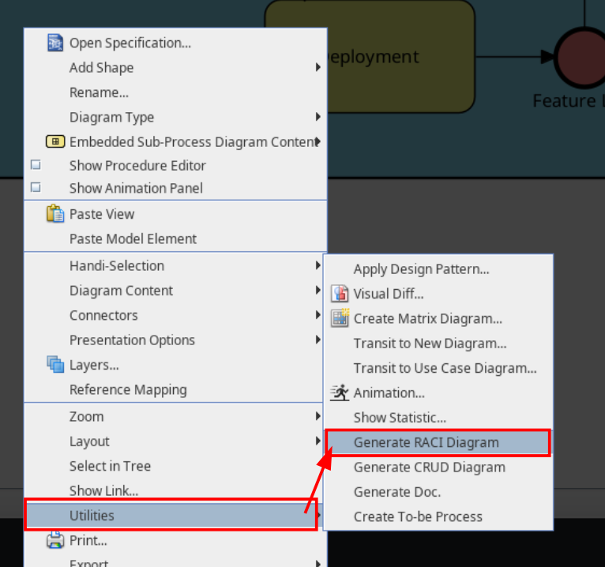
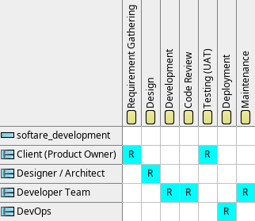
Generate RACI Diagram Automatically (Visual Paradigm)
7
Notes:
In this example, I used Visual Paradigm Standard to automate the core of the RACI matrix.
Instead of building it manually, you can simply right-click the diagram, navigate to Utilities, and select Generate RACI Diagram. This automatically maps the 'Responsible' party for every task, leaving you only to fill in the remaining roles.
From there, it's fully customizable, you can easily modify the symbols, colors, and layout to fit your needs.

Slide 8
RACI
Choosing the right tool
Project Management through Responsibility Assignment
Notes:
Online template (xlxs): https://online.visual-paradigm.com/app/office/#proj=0&type=Spreadsheet&import=The-RACI-Matrix.xlsx
So, we've covered what a RACI matrix is, why it matters, and what a project manager needs from it.
Now the question becomes: what software do we use to build and maintain it?
In the next slides I'll walk you through the functional requirements we defined, how we evaluated the available tools, and which one we will use and why.

Slide 9
Functional Specifications (1 of 3): Core Functionality
MoSCoW Method: Must Have | Should Have | Could Have | Won't Have
Functionality | Input | Output | Purpose | MoSCoW
Matrix Grid Editor | Drag/drop roles (columns) & tasks (rows) | Editable 2D RACI matrix | Creates the fundamental RACI structure with R/A/C/I cell assignments | Must Have
Role & Task Management | Add/remove/rename roles and tasks | Updated matrix reflecting all changes | Allows flexibility as project scope and team composition evolve | Must Have
Cell Assignment Logic | Click cell → select R/A/C/I from dropdown | Matrix cell populated with assignment | Enables rapid, consistent responsibility assignment across the team | Must Have
Data Validation Rules | Constraints: each task needs exactly ONE 'A' | Error warnings on invalid assignments | Prevents accountability ambiguity before it becomes a project issue | Should Have
6
Notes:
To define what the software must do, we use the MoSCoW method.
Matrix Grid Editor: Must Have. The 2D table structure is the foundation of any RACI tool.
Role & Task Management: Must Have. Projects evolve - the tool must handle that without breaking.
Cell Assignment Logic: Must Have. Click a cell, pick R/A/C/I from a dropdown. Fast and consistent.
Data Validation Rules: Should Have. Warns you when a task has no Accountable or has two. Prevents errors before they become real problems.

Slide 10
Functional Specifications (2 of 3): Collaboration & Export
MoSCoW Method: Must Have | Should Have | Could Have | Won't Have
Functionality | Input | Output | Purpose | MoSCoW
Real-Time Updates | Multiple users editing the matrix simultaneously | All users immediately see live changes | Team collaborates on assignment decisions without version conflicts | Should Have
Export to PDF/Excel | User selects export format and clicks export | Professional, stakeholder-ready document | Enables formal communication of responsibility assignments | Must Have
Comments on Cells | Hover over assignment, add rationale note | Persistent notes visible on hover/click | Documents WHY each responsibility decision was made | Could Have
Template Library | Select from pre-built RACI templates | Pre-populated matrix for common project types | Accelerates matrix setup for standard project categories | Could Have
7
Notes:
Real-Time Updates: Should Have. Multiple users editing simultaneously, no version conflicts.
Export to PDF/Excel: Must Have. At some point you need to share this outside the tool - two clicks and it's done.
Comments on Cells: Could Have. Documenting why each assignment was made adds valuable context.
Template Library: Could Have. Pre-built structures for common project types speed up setup.

Slide 11
Functional Specifications (3 of 3): Integration & Maintenance
MoSCoW Method: Must Have | Should Have | Could Have | Won't Have
Functionality | Input | Output | Purpose | MoSCoW
Version History / Audit Trail | Automatic logging of all edits and changes | Chronological record: who changed what and when | Tracks responsibility evolution and resolves assignment disputes | Should Have
Cloud Storage Sync | Save the matrix; link to Google Drive/OneDrive | Secure, hosted file accessible anytime, anywhere | Prevents data loss and enables remote/distributed team access | Must Have
Integration with PM Tools | Connect to Asana, Monday.com, or Jira task lists | RACI matrix synced with live project tasks | Keeps responsibility assignments aligned with actual execution | Could Have
Key Insight: Cloud storage and basic export are non-negotiable (Must Have). Version history and PM tool integration provide strategic value as the team matures their RACI practices.
11
Notes:
Version History: Should Have. Who changed what, and when - essential for resolving disputes.
Cloud Storage Sync: Must Have. One place, always accessible, never lost on someone's laptop.
PM Tool Integration: Could Have. Syncing with Asana or Jira keeps the matrix aligned with actual execution, but it's complex to set up.
Key takeaway: cloud storage and export are non-negotiable. Everything else adds value as the team matures.

Slide 12
Market Analysis: Comparative Tool Evaluation
We evaluated tools based on PM priorities: ease of use, real-time collaboration, export options, free tier availability, and learning curve for a 45-minute lab session.
Tool | Type | Producer | Price (USD) | Best For
Microsoft Excel / Google Sheets | Spreadsheet | Microsoft / Google | Free (For real) | Simple, familiar matrices - no learning curve; limited real-time collaboration
Asana | Project Management | Asana Inc. | Free (2 users) / $10.99-$24.99/user/mo | Full PM suite with RACI views - powerful but complex for RACI-only use
Monday.com | Project Management | monday.com Inc. | Free (2 users – 3 boards) / $9-$19/user/mo | Visual RACI + workflow automation - feature-rich but steep learning curve
Lucidchart | Diagramming | Lucid Software | Free (3 documents) / $7.95-$9/mo | Professional diagram visuals - not designed for responsibility matrices
Miro | Collaboration Canvas | Miro Inc. | Free (3 boards) / $8-$16/user/mo | Real-time collaboration canvas - flexible but unstructured for RACI work
12
Notes:
We evaluated five tools against our requirements, with a specific constraint: a 45-minute lab session, students, zero Budget, and no licensing problems.
Excel / Google Sheets: familiar, zero learning curve, grid maps perfect for RACI.
Asana / Monday.com: powerful PM suites, but overkill for RACI-only use in a short session.
Lucidchart: great for diagrams, but not built for matrix-style input.
Miro: flexible canvas, but too unstructured for a clean, readable RACI grid.

Slide 13
Recommended Tool: Google Sheets
★ Selected for: Simplicity + Accessibility + RACI-ready structure + Zero cost to students
WHY GOOGLE SHEETS?
WHY NOT THE OTHERS?
Native grid layout maps directly to RACI structure (roles = columns, tasks = rows)
Excel (Desktop)
No real-time collaboration in free version; requires installation
Real-time collaboration: entire class edits and views simultaneously
Asana / Monday.com
Overkill for RACI-only needs; 45 minutes isn't enough to learn the platform
Export to PDF and Excel in two clicks - stakeholder-ready output
Lucidchart
100% free with any Google account - no credit card, no trial expiry
Designed for diagrams - tables require workarounds; not intuitive for matrix input
Students already familiar with spreadsheets - minimal learning curve
Miro
Unstructured canvas makes RACI grids hard to align and read in presentation context
Conditional formatting enables color-coded R/A/C/I cells
Jira
Developer-focused; requires admin setup and organizational accounts
13
Notes:
Google Sheets wins on every dimension that matters here.
Grid layout maps directly to RACI - no translation needed.
Fully free, no-account setup beyond a Google login.
Everyone already knows how to use a spreadsheet.
Real-time collaboration and export work out of the box.
Conditional formatting enables color-coded R/A/C/I cells instantly.
The other tools either require installation, have steep learning curves, or are simply not designed for this task.

Slide 14
Getting Started with Google Sheets
A quick overview of Google Sheets as your RACI tool for this lab.
1
What is Google Sheets?
Google Sheets is a free, browser-based spreadsheet application. Its grid layout maps perfectly to a RACI matrix - no installation needed, accessible from any device.
2
Why Use It for RACI?
Real-time collaboration, easy sharing, built-in export to PDF and Excel, and conditional formatting for color-coded R/A/C/I cells - all for free with any Google account.
3
How We'll Use It
In this lab we use the Vertex42 RACI Matrix template modified to our needs (Shared by us) - a ready-made spreadsheet you download, open in Google Sheets, fill in, and export. No setup from scratch required.
4
Accessing Google Sheets
Visit sheets.google.com and sign in with any Google or Gmail account. It is completely free - no credit card or trial period required.
5
Sharing & Collaboration
Use the Share button (top right) to invite teammates. Everyone sees changes in real time - ideal for filling in a RACI matrix as a group during class.
6
Exporting Your Work
When finished, use File > Download to export as PDF or Excel (.xlsx). These formats are suitable for submitting your work or sharing with stakeholders.
7
Conditional Formatting
Apply color rules via Format > Conditional formatting to auto-color R/A/C/I cells. This makes your matrix instantly readable at a glance - a key visual best practice.
14
Notes:
A quick orientation before the exercise.
Google Sheets is browser-based — nothing to install, works on any device.
We use the Vertex42 RACI template, pre-adapted for today. No building from scratch.
Share via the Share button — everyone edits and views in real time.
Export via File → Download → PDF or Excel when finished.
Set up conditional formatting via Format → Conditional formatting to auto-color R, A, C, and I cells.

Slide 15
Exercise - Task 1: Download & Fill the Template
Scenario: Website Redesign Project | Use the Vertex42 RACI Matrix template
YOUR ASSIGNMENT
EXAMPLE: 'Create Mockups' Row
1. Go to our shared RACI Matrix.xlsx and download the free RACI Matrix template. Open it in Google Sheets via File > Import > Upload > Examine my PC
Role | Assignment | Rationale
Designer | R | Does the design work
Project Manager | A | Approves final mockups
Developer | C | Consulted on feasibility
Client | C | Consulted on vision/brand
2. Replace the template's placeholder roles (columns) with: Project Manager, Designer, Developer, Client.
Replace placeholder tasks (rows) with: Define Requirements | Create Mockups | Code Frontend | Code Backend | User Testing | Deploy
3. Fill in each cell with R, A, C, or I. Follow the template’s built-in color coding. Rules: each task needs exactly ONE A, at least one R, and C/I used only where genuinely needed.
💡 Pro Tips
• The template already includes color coding - keep it; it makes your matrix instantly readable • Only ONE 'A' per row - if you want two, decide who truly owns the outcome • Use comments (Insert > Comment) to justify at least 2 of your assignment choices
4. Rename your file to Lab6_RACI (click the filename at top). Then add a short comment next to at least two cells explaining your reasoning - use Insert > Comment in Google Sheets.
15
Notes:
Scenario: Website Redesign Project.
Roles: Project Manager, Designer, Developer, Client. Tasks: Define Requirements, Create Mockups, Code Frontend, Code Backend, User Testing, Deploy.
Download the shared template and open it in Google Sheets via File → Import.
Replace placeholder roles and tasks with the ones above.
Fill every cell. Keep the color coding. Rules: exactly one A per task, at least one R, C and I only where genuinely needed.
Rename the file Lab6_RACI and add a comment to at least two cells explaining your reasoning.

Slide 16
Exercise - Task 2: Export & Documentation
Export your completed modified template from Task 1 in multiple formats
1
2
3
Export as PDF
Export as Excel (.xlsx)
Share via Link
In Google Sheets: File → Download → PDF Document (.pdf)
Make sure "Current sheet" is selected. Click Export.
In Google Sheets: File → Download → Microsoft Excel (.xlsx)
The file downloads instantly - keep it as a backup of your original template work.
Click Share (top right) → Change access to "Anyone with the link can view" → Copy the link. Submit this link along with your exported PDF and Excel files.
Reflection Questions - Add Your Answers as a Comment or Text Box in the Spreadsheet:
Q1: What differences do you notice between the PDF and Excel exports? Which format would you send to a client and why?
Q2: When sharing your matrix with someone who was not in the room, what context would they need that the template alone does not provide? How could you add that context?
16
Notes:
Once the matrix is complete, export it in two formats and generate a shareable link.
PDF: File → Download → PDF Document. Select current sheet, click Export.
Excel: File → Download → Microsoft Excel. Keep it as a backup.
Link: Share → Anyone with the link can view → Copy and submit alongside the files.
Reflection questions to answer directly in the spreadsheet:
Q1: What differences do you notice between PDF and Excel? Which would you send to a client?
Q2: What context would someone need that the template alone doesn't provide? How would you add it?

Slide 17
Exercise - Task 3: Real-World Application
Individual or Group Activity | Be creative - use a scenario you know!
STEP 1 - Choose Your Scenario
Pick a real situation you are familiar with. You will build a RACI matrix around it from scratch.
Example ideas: Planning a student event | Building a group class project | Organizing a hackathon | Launching a small online store | Running a sports tournament | Setting up a campus club
STEP 2 - Build Your RACI Matrix (Minimum Requirements)
• Minimum 4 roles (e.g., Organizer, Sponsor, Volunteers, Participants) • Minimum 6 tasks (plan your scenario comprehensively) • Proper R/A/C/I distribution: Each task has exactly ONE A, most have an R, and C/I are used strategically (not as defaults)
STEP 3 - Document Your Rationale
In a text box or comment column, answer: Why is [Person] accountable for [Task]? Who else was considered? Who needs consultation vs. just notification? (Just for one task of your choice)
17
Notes:
Now apply RACI to something you actually know.
Step 1: Choose your own scenario — an event, a group project, a club, a hackathon. Anything real.
Step 2: Build from scratch. Minimum 4 roles, minimum 6 tasks. One A per task, R where work is done, C and I used strategically.
Step 3: Document your rationale for at least one task. Why is this person accountable? Who else was considered? Who needs consultation vs. just notification?
This is where the concept becomes a real skill.

